Slide 1
The Transcript of the First Meeting of THE ALLIANCE OF YOUTH LEADERS IN THE UNITED STATES

Slide 2
Kathy (Host):
Hi everyone! I am Kathy Wang, and I’ll be the host of today’s meeting.
I would like to introduce our co-hosts for today:
William John (12th Grade, from Highland Park High School, NJ)
Christie Yu (10th Grade, from Wellesley High School, MA)
Aric Zhuang (11th Grade, from Great Neck South High School, NY)
Now over to William, who will kick-off the start of this meeting.

Slide 3
William:
Today, the day after Independence Day, we have gathered together to mark the formal start and inaugural meeting of THE ALLIANCE OF YOUTH LEADERS IN THE UNITED STATES. The meeting will now commence.

Slide 4
Kathy (Host):
And now Aric – details about social media contact and outreach?
Aric Zhuang:
Hi everyone, we have currently have a website: www.aylus.org
Facebook group: https://www.facebook.com/groups/aylus/
We will be using these platforms to connect to our members, as well as to mediums of communication. So if you have not joined the group yet, please feel free to do so.

Slide 5
Kathy:
Christie, William, and Aric will now introduce the founders of THE ALLIANCE OF YOUTH LEADERS IN THE UNITED STATES.

Slide 6
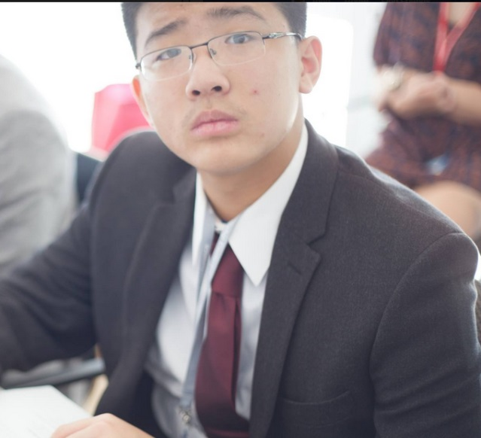
Founders of Alliance of Youth Leaders
William John
12th Grade
Sciences, Basketball
Highland Park High
New Jersey

Slide 7
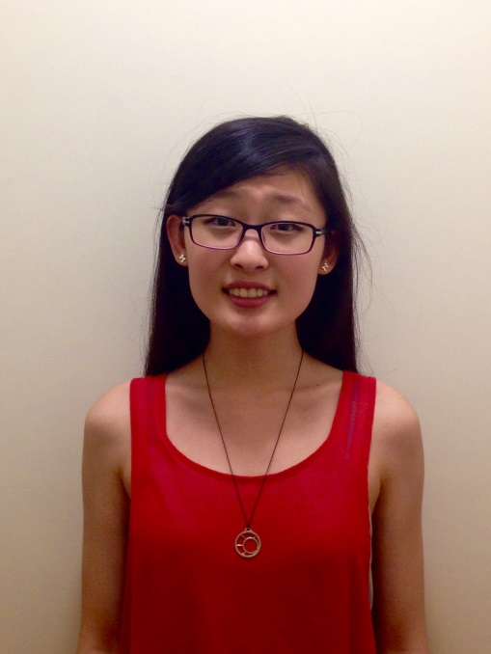
Founders of Alliance of Youth Leaders
Christie Yu
10th Grade
Art, Writing
Wellesley High School
Wellesley, MA

Slide 8
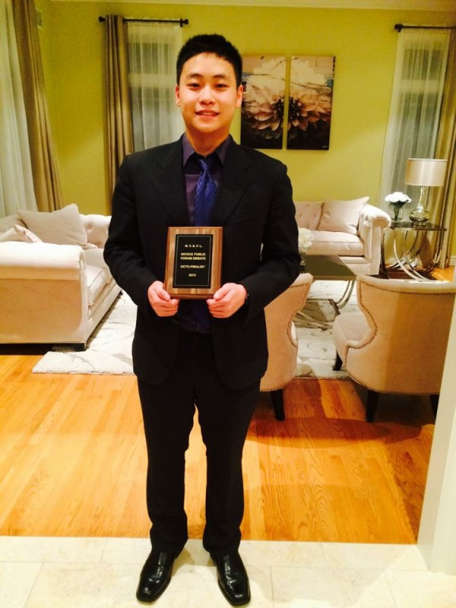
Founders of Alliance of Youth Leaders
Aric Zhuang
11th Grade
Web Design, Debate
Great Neck South High
Great Neck, New York

Slide 9
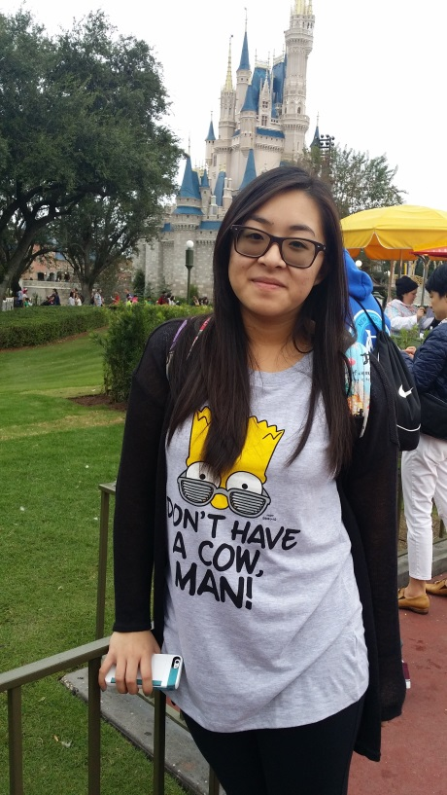
Founders of Alliance of Youth Leaders
Stephanie Than
11th Grade
Art, Music
Hunter College High
New York

Slide 10
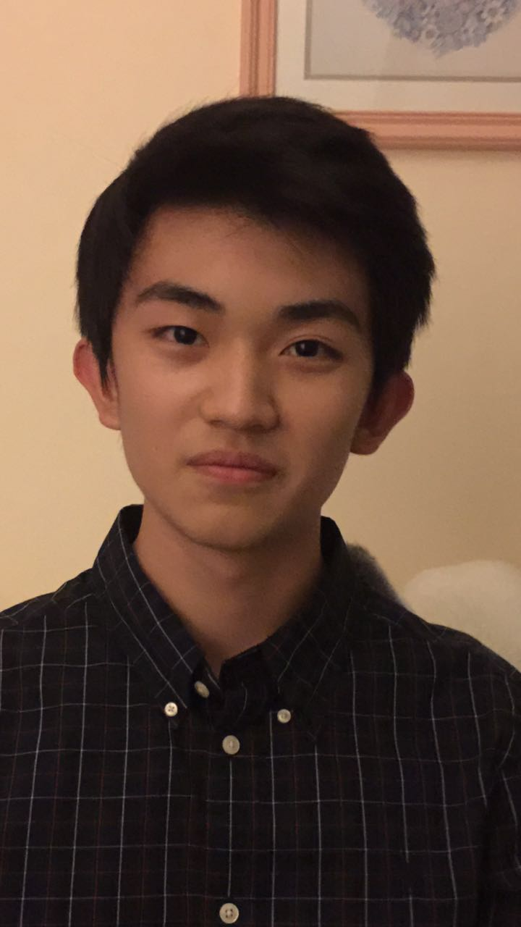
Founders of Alliance of Youth Leaders
Jackie Du
12th Grade
Video Game, Piano
Jackson Memorial High
New Jersey

Slide 11
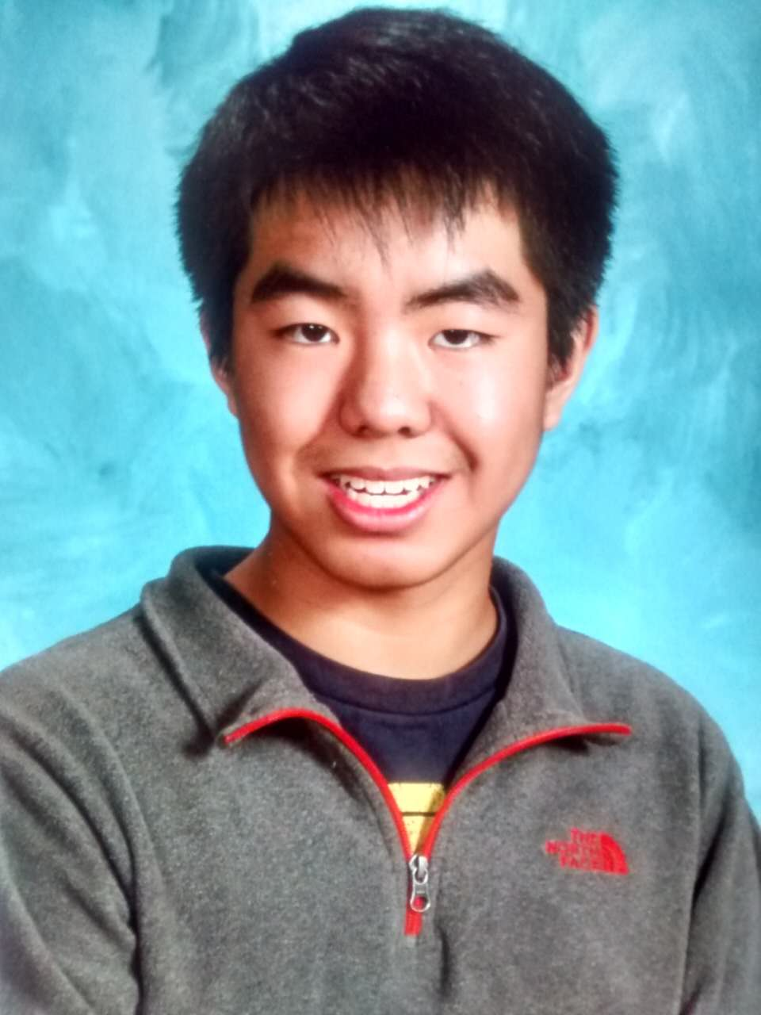
Founders of Alliance of Youth Leaders
Allen Xu
11th Grade
Speech, Soccer
Lexington High School
Lexington, MA

Slide 12
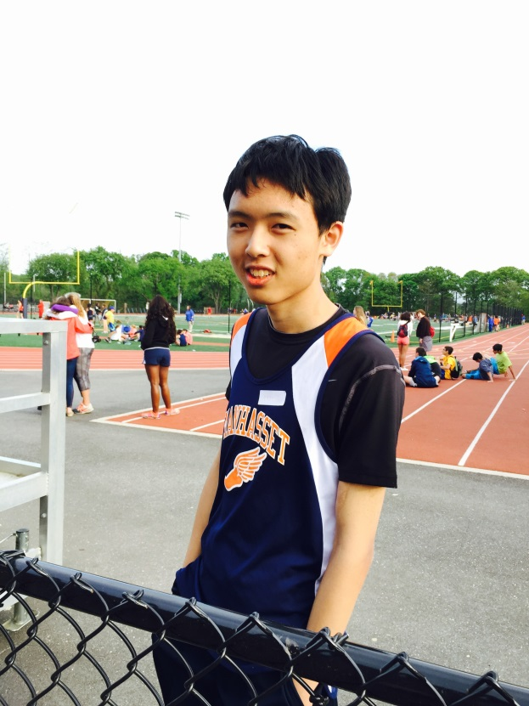
Founders of Alliance of Youth Leaders
Hill Yin
11th Grade
Math, Physics , History
Manhasset Secondary School
Manhasset, New York

Slide 13
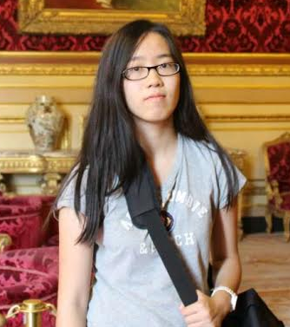
Founders of Alliance of Youth Leaders
Meiyu Zeng
11th Grade
Art, Math, Music, CS
Cinco Ranch High Katy, TX

Slide 14
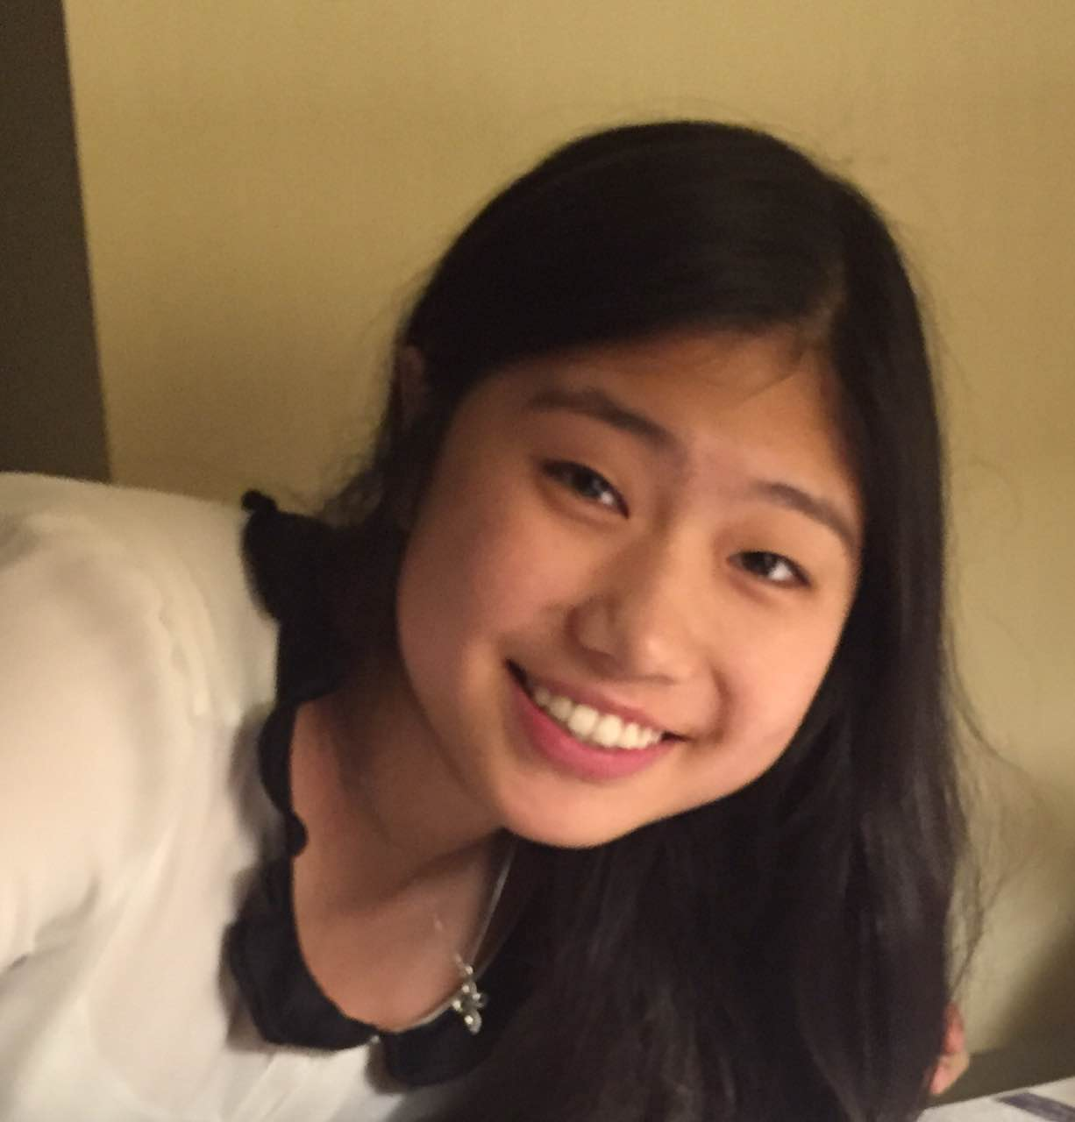
Founders of Alliance of Youth Leaders
Clio Sun
11th Grade
Music, Engineering
Seven Lakes High School
Katy, TX

Slide 15
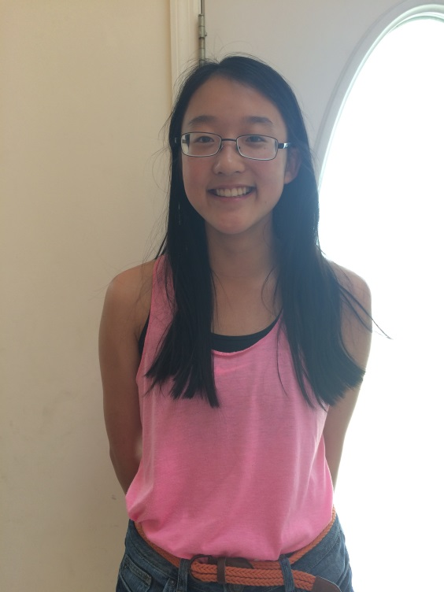
Founders of Alliance of Youth Leaders
Daiyao Zhang
11th Grade
Piano, Field Hockey
Oyster River High School
New Hampshire

Slide 16
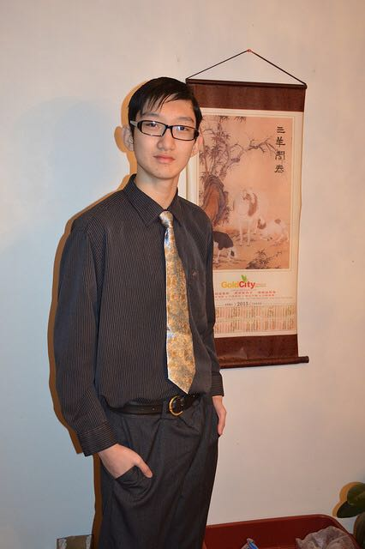
Founders of Alliance of Youth Leaders
Dragon Peng
10th Grade
Fencing, Violin, Basketball, Graphic Design Half Hollow Hills
New York

Slide 17
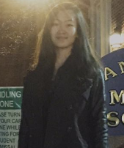
Founders of Alliance of Youth Leaders
Iris Liu
10th Grade
Mandarin, Piano
Manhasset High school
Manhasset, NY

Slide 18
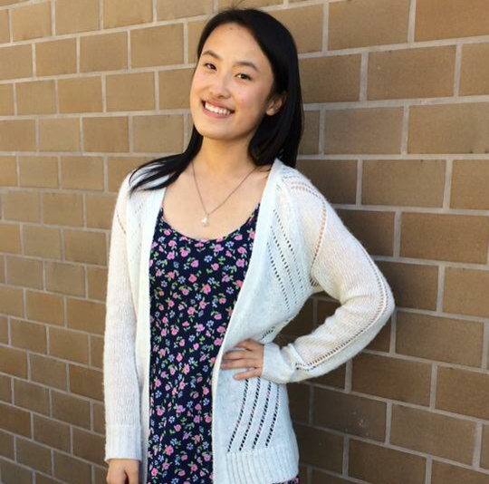
Founders of Alliance of Youth Leaders
Luvena Huo
10th Grade
Ping Pong, Speech, Dance, Music
Dougherty Valley High
CA

Slide 19
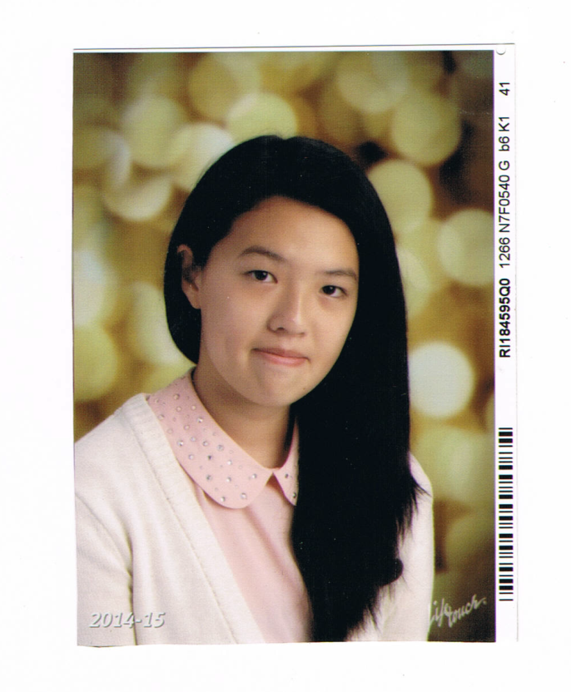
Founders of Alliance of Youth Leaders
Elizabeth John
10th grade
Art , Violin
Highland Park High
New Jersey

Slide 20
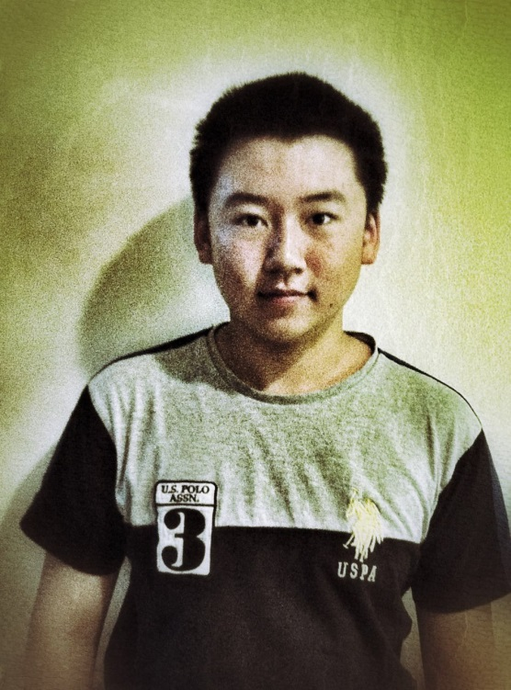
Founders of Alliance of Youth Leaders
Alex Lin
10th Grade
Chess
Brentwood School
California

Slide 21
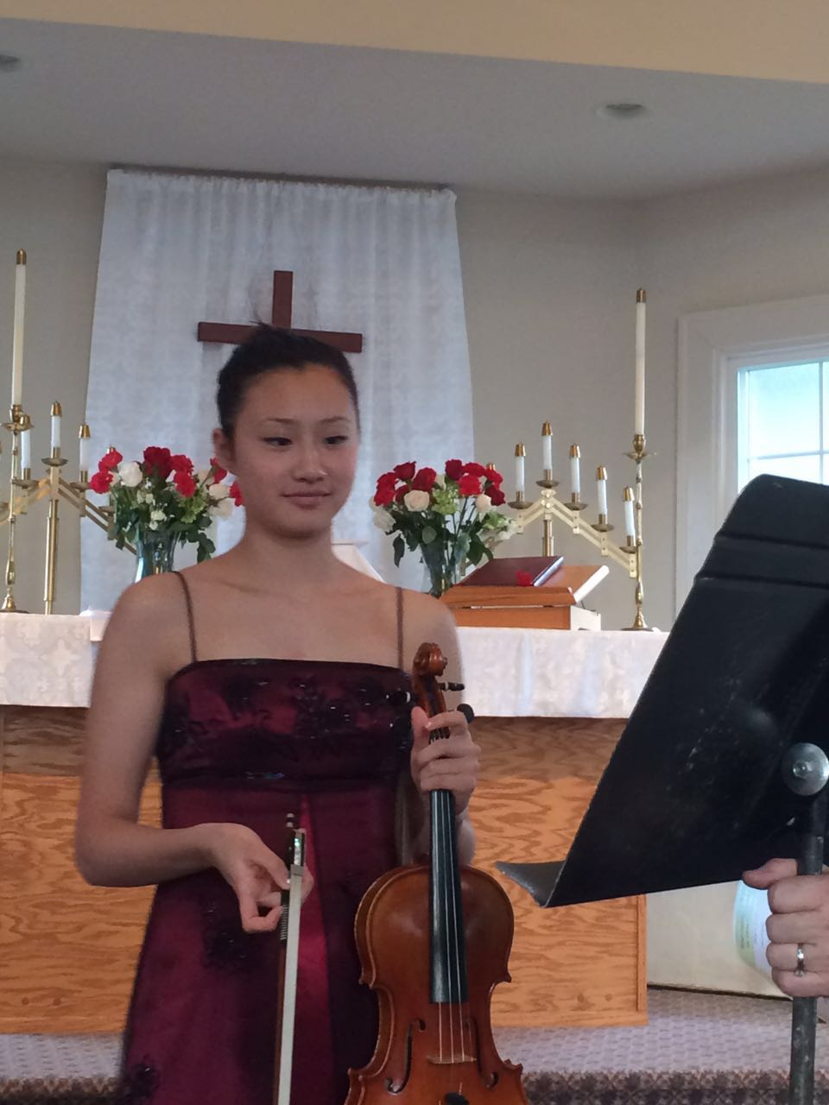
Founders of Alliance of Youth Leaders
Yani Le
10th Grade
Swimming
Squalicum HS
WA

Slide 22
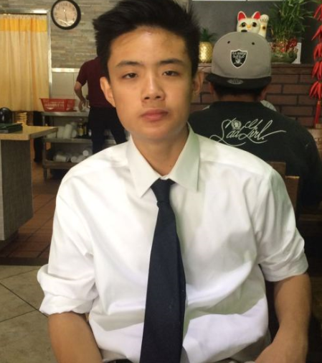
Founders of Alliance of Youth Leaders
Leo Tong
10th Grade
Basketball, Music, Design, Programming
Archbishop Mitty High
San Jose, CA

Slide 23
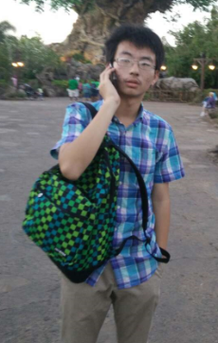
Founders of Alliance of Youth Leaders
Gan Liu
10th Grade
Robotics, Science
Clear Brook high school
TX

Slide 24
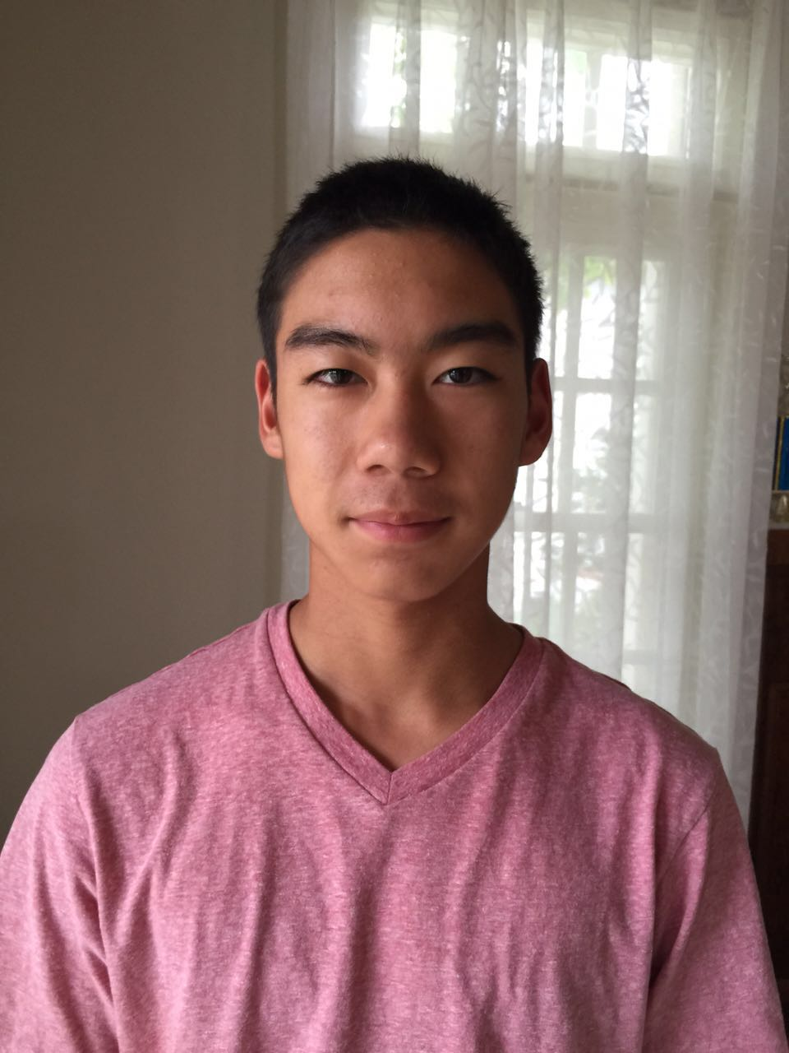
Founders of Alliance of Youth Leaders
Ryan H. Liu
10th Grade
Tennis, Piano, Video Production
Palos Verdes Peninsula High
California

Slide 25
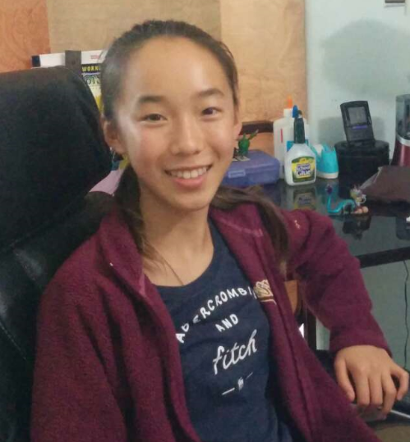
Founders of Alliance of Youth Leaders
Amy L. You
10th Grade
Science, Chinese Culture
Laguna Beach High
Laguna Beach, CA

Slide 26
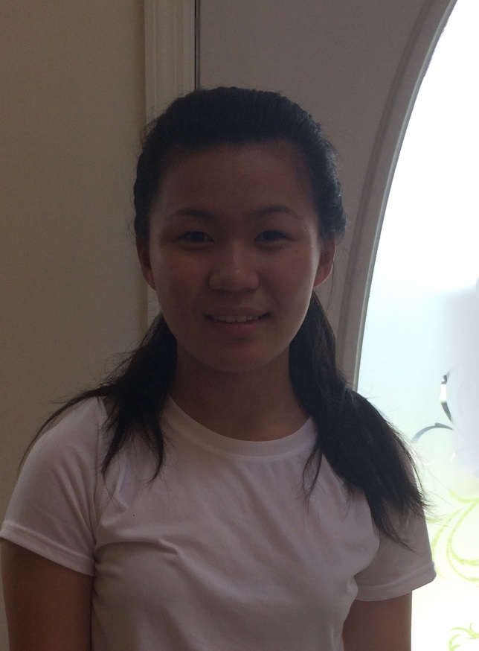
Founders of Alliance of Youth Leaders
Michelle Cheng
10th Grade
Tennis, Saxophone
Amity Regional High
CT

Slide 27
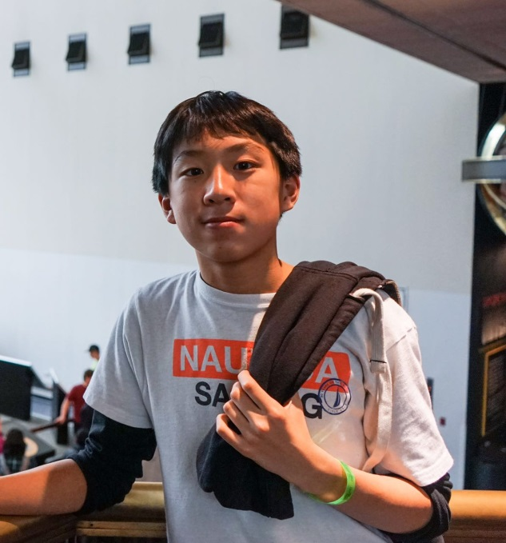
Founders of Alliance of Youth Leaders
Eric Wu
9th Grade
Math, Programming, Tennis, Swimming
Clements High School
Sugar Land, Texas

Slide 28
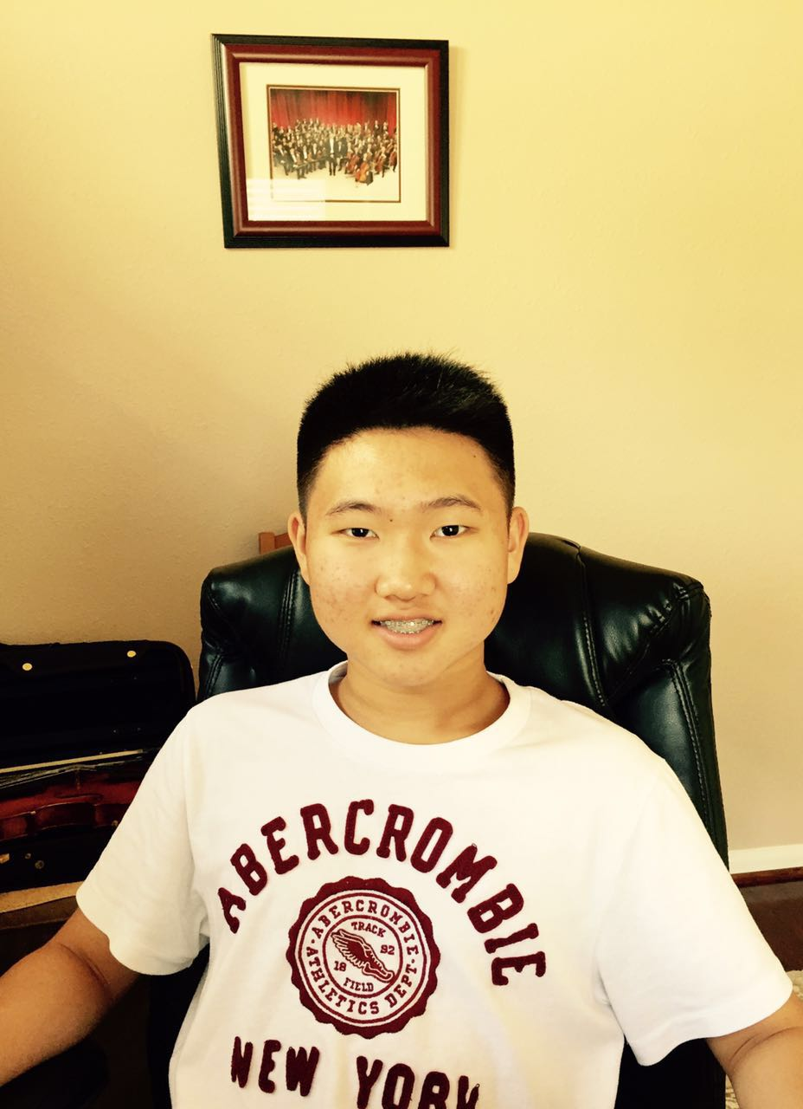
Founders of Alliance of Youth Leaders
Jonathan Liu
9th Grade
Music, Science, Math, Debate, Teaching
Seven Lakes High School
Katy, Texas

Slide 29
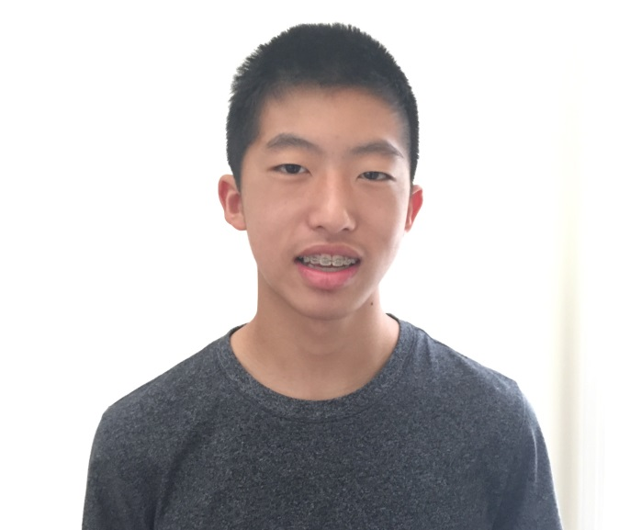
Founders of Alliance of Youth Leaders
George Cao
9th Grade
Programming
McLean High School
VA

Slide 30
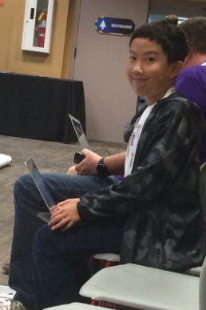
Founders of Alliance of Youth Leaders
Ryoya Yan
9th Grade
Computer Programming
Canyon Crest Academy
CA

Slide 31
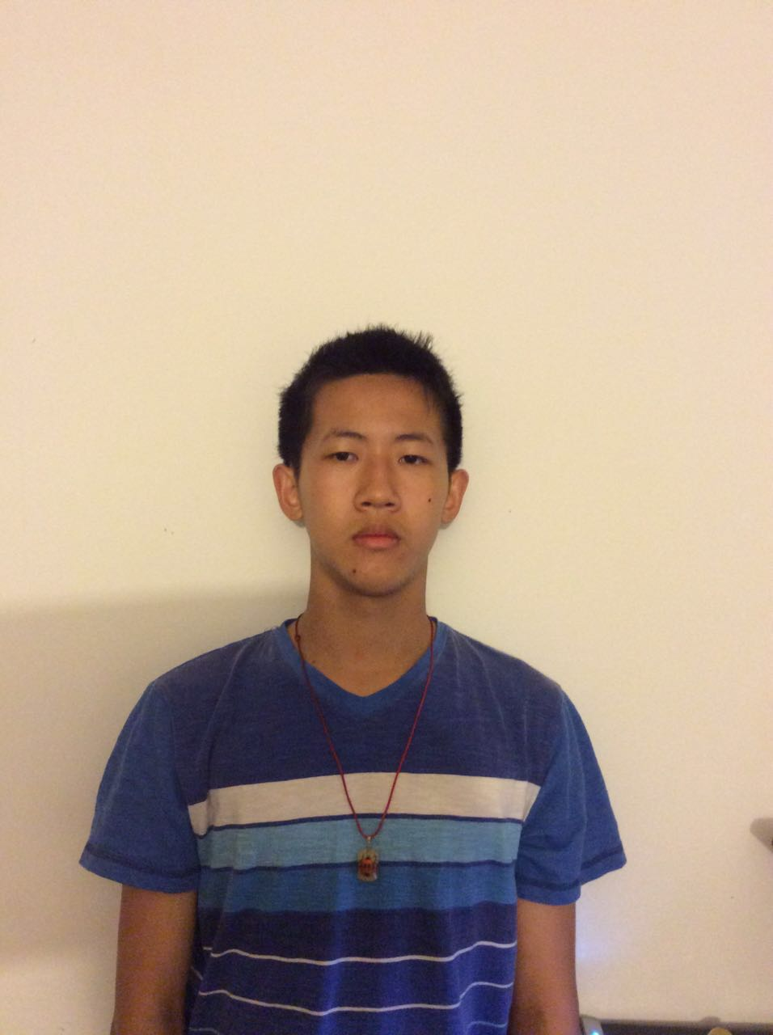
Founders of Alliance of Youth Leaders
Yansong Tang
9th Grade
Kung Fu, Soccer, Video Games, Strategy Games
William Fremd High
Illinois

Slide 32
Christie:
And now… the Junior founders of THE ALLIANCE OF YOUTH LEADERS IN THE UNITED STATES.

Slide 33
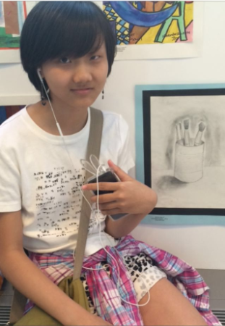
Junior Founders of Alliance of Youth Leaders
Julia He
New York

Slide 34
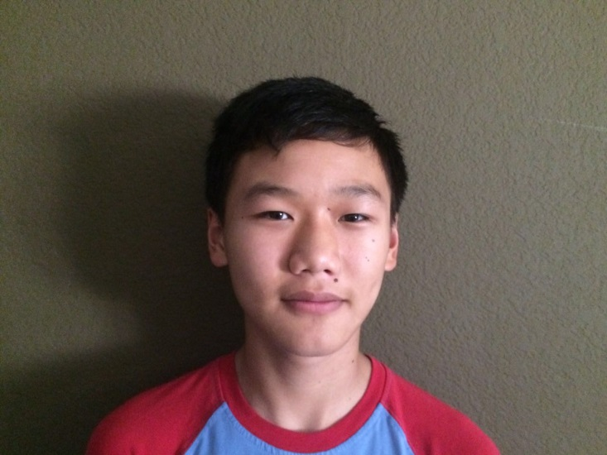
Junior Founders of Alliance of Youth Leaders
Derrek Fan
CA

Slide 35
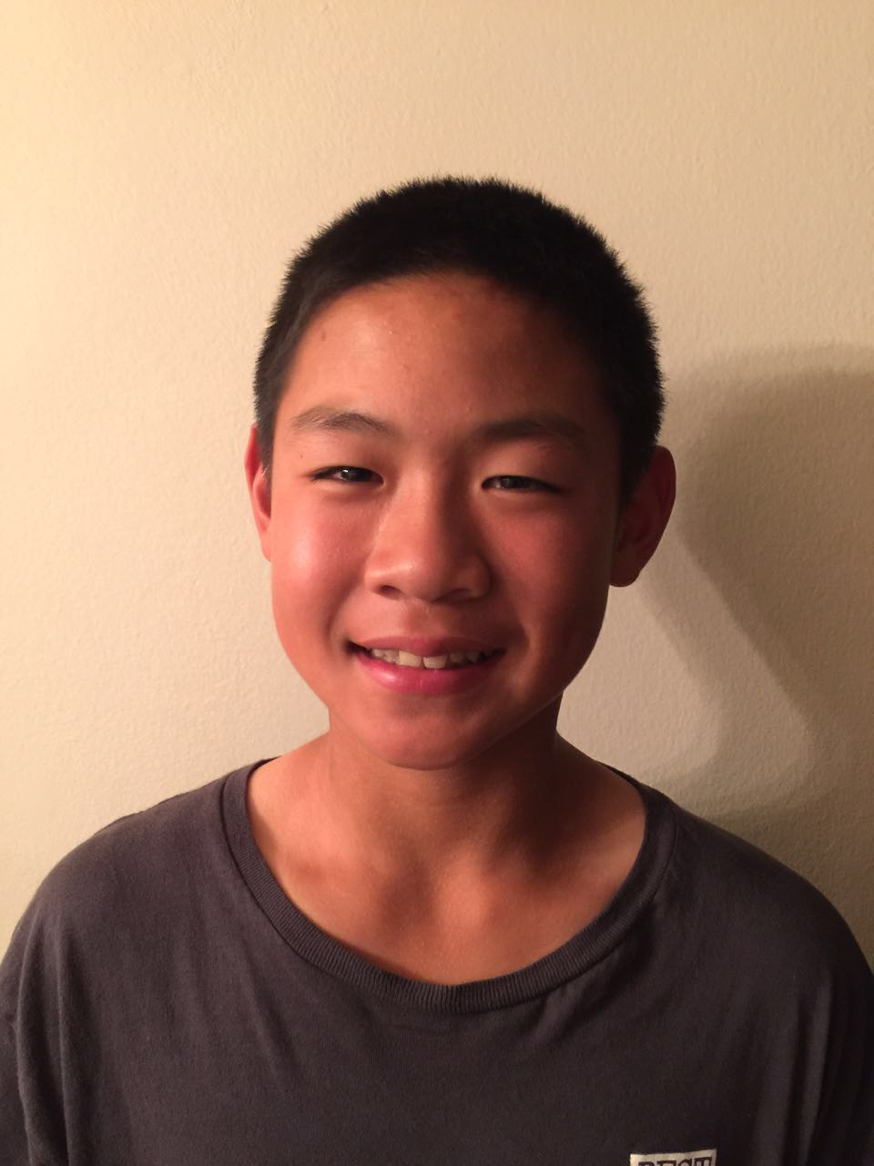
Junior Founders of Alliance of Youth Leaders
Kevin J. Liu
California

Slide 36
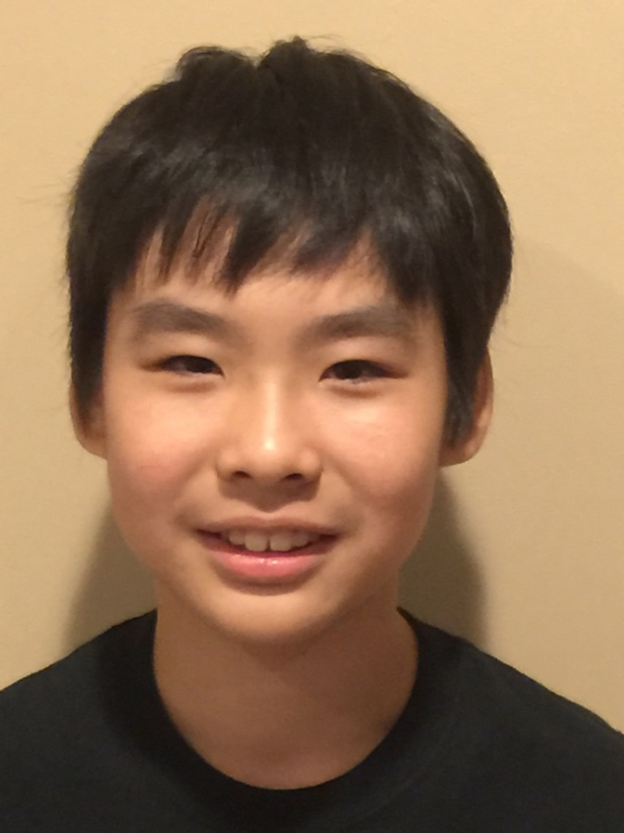
Junior Founders of Alliance of Youth Leaders
Max Su
New York

Slide 37
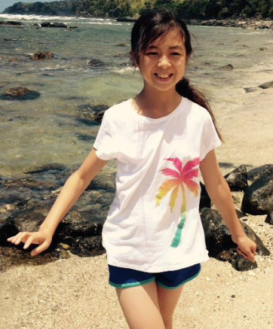
Junior Founders of Alliance of Youth Leaders
Jessica Fan
CA

Slide 38
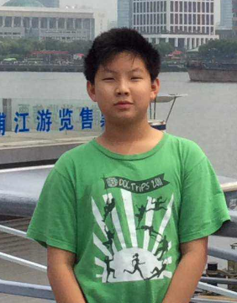
Junior Founders of Alliance of Youth Leaders
David Lin
Texas

Slide 39
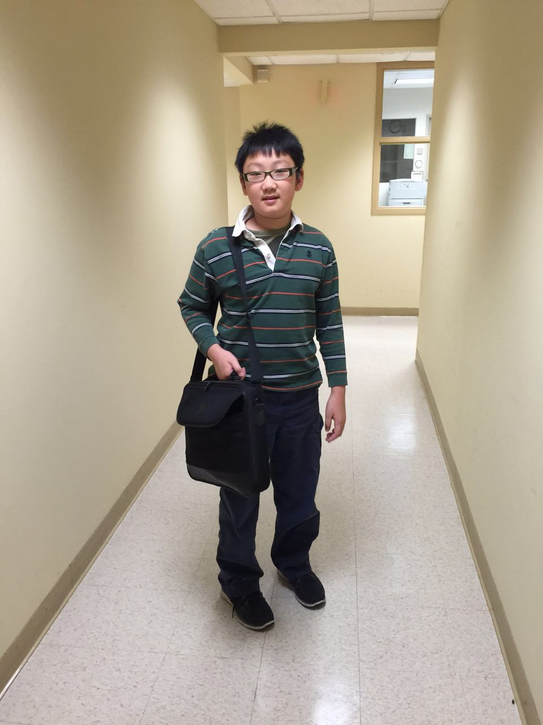
Junior Founders of Alliance of Youth Leaders
Tiger Peng
New York

Slide 40
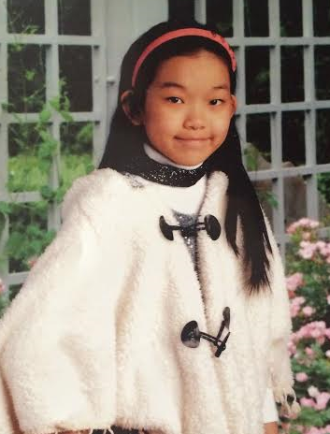
Junior Founders of Alliance of Youth Leaders
Meena He
NEW YORK

Slide 41
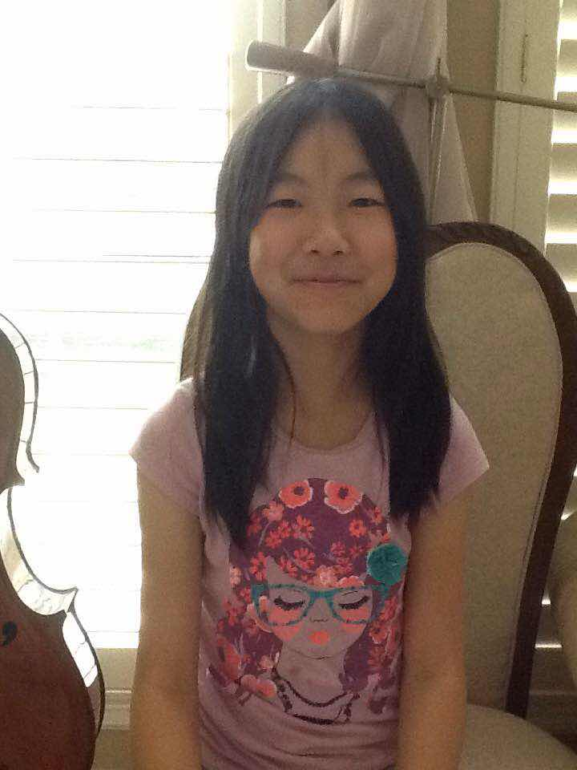
Junior Founders of Alliance of Youth Leaders
Jenny Xun
Texas

Slide 42
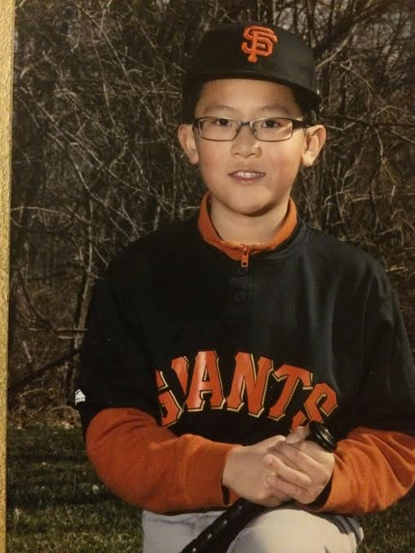
Junior Founders of Alliance of Youth Leaders
Ethan Zhou
VA

Slide 43
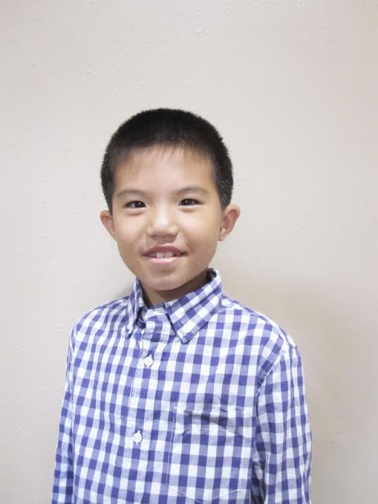
Junior Founders of Alliance of Youth Leaders
Neal Pang
Texas

Slide 44
Christie:
I’d now like to re-introduce our host, Kathy Wang. Kathy recently graduated from Harvard College, where she held positions in a number of student organizations, such as editorial writer for the Harvard newspaper, The Crimson. She also served as the Gates Scholarship local representative for MA, and she is a guest speaker for Ronald McDonald House Charities outreach seminars.
Kathy will serve as the volunteer advisor for THE ALLIANCE OF YOUTH LEADERS IN THE UNITED STATES.
Now let’s welcome Kathy to deliver the keynote speech for today’s meeting of AYLUS.

Slide 45
Kathy: Keynote
Thank you Christie + AYLUS, volunteer advisor
Topic: why community service is important, why AYLUS can help – connect students w/ similar interests, power of the collective
College – leadership + community service, not just being smart Why? → successful = 1. problem solvers, 2. aware of the world, 3. want to bring people together; innovative
Beyond college –be grateful to your community and support network // community presents opportunities and experiences, growth
What can HS students do?
Students are busy doing other things - Idea generation
Students too young -- Getting support
AYLUS’s role in these two – creativity/flexibility --bounce ideas, support for members, connect across nation, collective action
Close: excited to work with members

Slide 46
Kathy (Host):
And now, William John, can you share with us the mission of THE ALLIANCE OF YOUTH LEADERS IN THE UNITED STATES

Slide 47
William:
The Alliance of Youth Leaders in the United States (AYLUS) promotes the development of its members’ creativity, leadership, and initiative, through the planning and execution of volunteer projects that aim at benefitting their communities.

Slide 48
Kathy (Host):
Now, Christie, can you explain the structure of the Alliance of Youth Leaders

Slide 49
Christie:
Leadership Structure
AYLUS will be structured around one National and several Local leadership groups:
National leadership:
The National leadership positions include: President, Vice President, Secretary, and Treasurer, as well as committee heads and their deputies for individual activities committees. National committees will include, but are not limited to, the following subject areas:
Art, Music, and Literature
Science and Engineering
International Relations
Public Relations
Business Management
Information Technology
Nation-wide projects will be coordinated through corresponding committees. AYLUS encourages students with the dedication and interests to found new departments as the need arises
Leaders will serve one year terms; new leadership positions will open in May so that AYLUS can prepare for summer activities.

Slide 50
Kathy (Host):
So Aric, can you explain the structure of the local branches of our organization?

Slide 51
Aric:
Local leadership:
Local leadership positions include: President, Vice President, and Secretary.
We encourage students to develop local branches so that they may engage in activities within their local communities. Each local branch decides upon its own project and shall receive support from AYLUS as well as other branches.

Slide 52
Kathy (Host):
William, can you explain how AYLUS will function going forward?

Slide 53
William:
Volunteer Hours
Of course, Kathy. Students will be creating their own unique projects, and will receive corresponding community service credit for the hours spent preparing and executing each activity or program; for instance, if AYLUS holds a student art auction for charity, the AYLUS Art Committee will be responsible for allocating community service hours to each artist, commensurate with the number of hours spent creating the art piece, organizing the event, etc. At the end of the year, students who accumulate enough community service hours will receive a certificate for the President’s Volunteer Service Award. More information on this can be found on the website.

Slide 54
Kathy (Host):
Christie, do you have an example of how to design and conduct a project?

Slide 55
Christie:
Yes. For example, if you love playing chess, AYLUS can work with you to set up a series of video chess tutorials for beginners. AYLUS will help promote and distribute these videos. Throughout this process, you will learn how to use your talents to contribute to the wider community, develop viable products, connect with chess players, demonstrate creativity and leadership skills, and much more. AYLUS leadership will credit community service hours to the players, corresponding to the hours you spent in producing these chess tutorials.

Slide 56
Kathy (Host):
William, what about…video game enthusiasts? Are there projects for them too?

Slide 57
William:
Yes, if you’re a game lover… AYLUS can set up a project, such as “Build Your Own Game,” with you. You can work with a group of fellow members to carry out Arduino or Raspberry Pi projects. Group members will help each other and share their knowledge and skills. Upon project completion, group members will make video demo presentations. AYLUS will circulate these videos to encourage their peers to start their own projects to promote creativity and passion for technology. AYLUS leadership will credit community service hours to these gamers, corresponding to the hours spent on projects and demos.

Slide 58
Kathy (Host):
Aric, do you have any idea what the kids who love information technology can do?

Slide 59
Aric:
Of course, if you’re a web designer…, you can join the IT committee of AYLUS to help update and maintain our website. AYLUS will honor the time you spend in community service hours.

Slide 60
Kathy (Host):
William, Christie, and Aric, for members who want to start their own projects, what kind help can AYLUS offer?

Slide 61
Christie:
If you’re a self-starter...create your own project! As long as your project has a positive impact on the community, AYLUS can create a new club for you and offer support. There is no timeline or strict guidelines – feel free to be creative! AYLUS will honor the time spent on these projects with community service hours.

Slide 62
William:
AYLUS will always stand by our talented members. With the support of AYLUS and your fellow members, you can fully widen your reach, hone your skills, and build your own path to success.

Slide 63
Kathy (Host):
Now it’s time for Q & A! If anyone has questions, please call
845-521-7540
once again:
845-521-7540
Or, post your Qs on our Facebook Group
www.facebook.com/groups/aylus/

Slide 64
William, Christie, Aric, and Kathy: Now let’s answer some questions people may have.

Slide 65
What is the function of AYLUS?
William: AYLUS promotes creativity, leadership, and initiative in its student members nationwide. AYLUS strives to develop the potential of its members to both benefit the individual as well as the community.

Slide 66
Is AYLUS 100% student run?
Christie: Yes to a degree, students are completely responsible for running AYLUS, although certain activities will be subject to approval and supervision from the Board of Advisors.

Slide 67
How will AYLUS ensure the community hours given to people are fair and appropriate?
Aric: The motto of AYLUS is “Leadership, Integrity, and Innovation”. AYLUS will always conduct its activities in a fair and honest manner. Corresponding AYLUS committee members will decide, as a group, on the number of service hours to be given. The committee is responsible for communicating with the person receiving the hours and provide their decision rationale. If the recipient feels that their hours are unfair, they may appeal to the Board of Advisors.

Slide 68
Who can join AYLUS? How? Is there any criteria needed in order to join AYLUS?
William: Anyone with the dedication and motivation to make an impact on their community can join AYLUS. AYLUS members, however, must be between 9th and 12th grades.
Junior AYLUS members must be between the grades of 1st and 8th. Junior AYLUS members are required to have parental supervision for any volunteer work.

Slide 69
If I’m interested in promoting one specific topic or project, who should I reach out to?
Christie: That’s a great question – if you’re interested in something specific, you can request to create a national club. To do so, you can reach out to the appropriate committee-topic head, the National President, and the Board of Advisors.
Details about this process will be posted on our website.

Slide 70
How do you create a local branch?
William: Contact the National President and the Board of Advisors in order to start a local branch. Once a local branch is recognized, it can immediately begin receiving support from the National organization.
Details about this process will also be posted on our website.

Slide 71
How and when will AYLUS leaders be chosen?
Aric: AYLUS leaders will be chosen by the beginning of May on an annual basis, in order to accommodate upcoming summer projects. To be eligible, applicants must:
Be an AYLUS member
Complete a position-specific application
Interview with the Board of Advisors. AYLUS
Members will be evaluated on their historical contribution and commitment to AYLUS.

Slide 72
Kathy (Host): Closing remarks
Well looks like its time to wrap things up for today– if anyone else has any questions, now or later, please post in the AYLUS Facebook group and someone will get back to you ASAP.
And thank you all for joining us for the inaugural kick-off of AYLUS! We appreciate the feedback and questions we’ve received and look forward to working together to make a positive impact in our communities! Have a great evening everyone!

Slide 73
What is AYLF and what is its relation to AYLUS?
Aric: AYLF, or the American Youth Leadership Foundation, is AYLUS’s parent organization. AYLF is a non-profit organization created and operated by a group of adult volunteer workers. AYLF will help AYLUS members in the development and execution of projects that will be beneficial to communities, supply necessary financial and material support to the projects carried out by AYLUS, and provide advisory and consulting services to AYLUS. Its website is at: www.aylfus.org.

